Slide 1
Factors that Drive Home Prices
BY DANIEL PELLEGRINI

Slide 2
Home Characteristics that Affect Prices
There are many internal and external factors that can influence a home’s price. The latter consists of the economy, the city’s location relative to a body of a water, etc. The focus of this presentation will be on numerous internal factors that have a strong correlation to home values.
Neighborhood
1st Floor Square Foot, Number of Full Bathrooms, and Central Air Conditioning Availability
House Style
Some background information regarding this presentation.
Location: Ames, Iowa
Average Home Sales Price: ~$180k
Number of Homes: 1460 houses
Number of Home Variables: 81 (includes ID and sales price)
Information from Kaggle.com: https://www.kaggle.com/c/house-prices-advanced-regression-techniques/overview

Slide 3
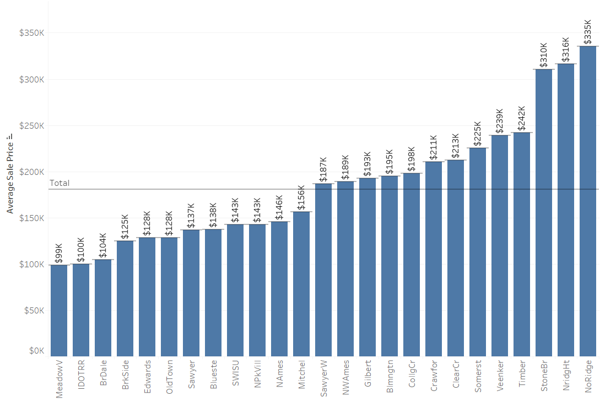
Neighborhood
There is a statistical difference in home prices due to neighborhood
There are 12 neighborhoods below the average sales price and 13 neighborhoods above it
Noridge has the most expensive neighborhood at an average home price of about $335k and MeadowV is the least expensive neighborhood at $99k

Slide 4
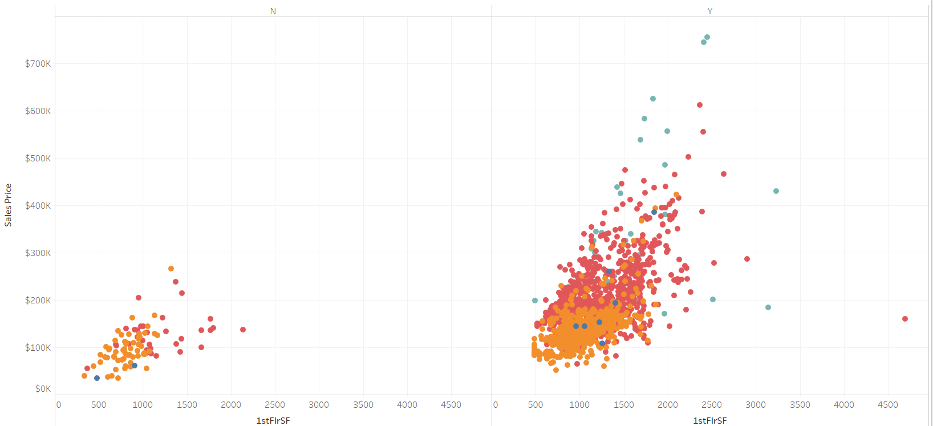

1st Floor Square Foot and Central Air Conditioning Availability
There is a significant difference in home prices due to the square foot of the 1st floor and/or whether central air-conditioning is available
Homes with 2 full bathrooms have higher sales prices than homes with 1 full bathroom

Slide 5
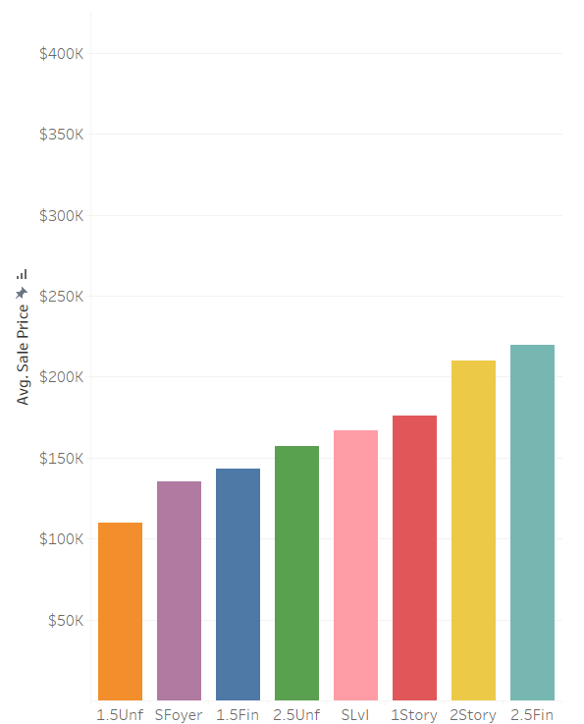
House Style
House style makes a significant difference in affecting the sales prices of homes
Houses that are 2 and a half stories with the 2nd level finished have the highest average sales price
Houses that are 1 and a half stories with the 2nd level unfinished have the lowest average sales price

Slide 6
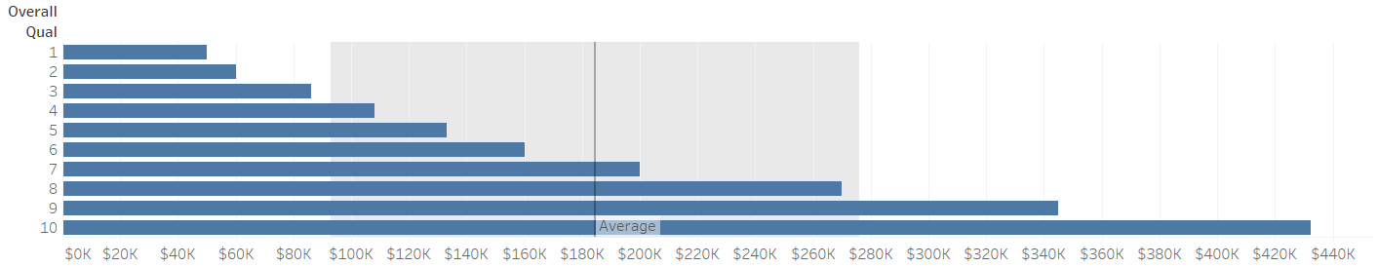
Conclusion
Average home prices are affected by numerous factors
Neighborhood
1st Floor Square Foot and Central Air Conditioning Availability
House Style
Recommendation: Invest in a house in an above-average neighborhood with central air-conditioning and that has a 1st floor square footage of at least 1518 square feet. Moreover, the house style should be one of the following: split level, 1-story, 2-story, or 2 and a half stories with the 2nd level finished.
Lastly, the overall quality of a home was neglected in this study because of its obviousness to affecting a home’s average sales price as seen below.

